Slide 1

The Wokaty Family
Past, Present, Future

Slide 2
Over 17 years in Hermosillo

Slide 3
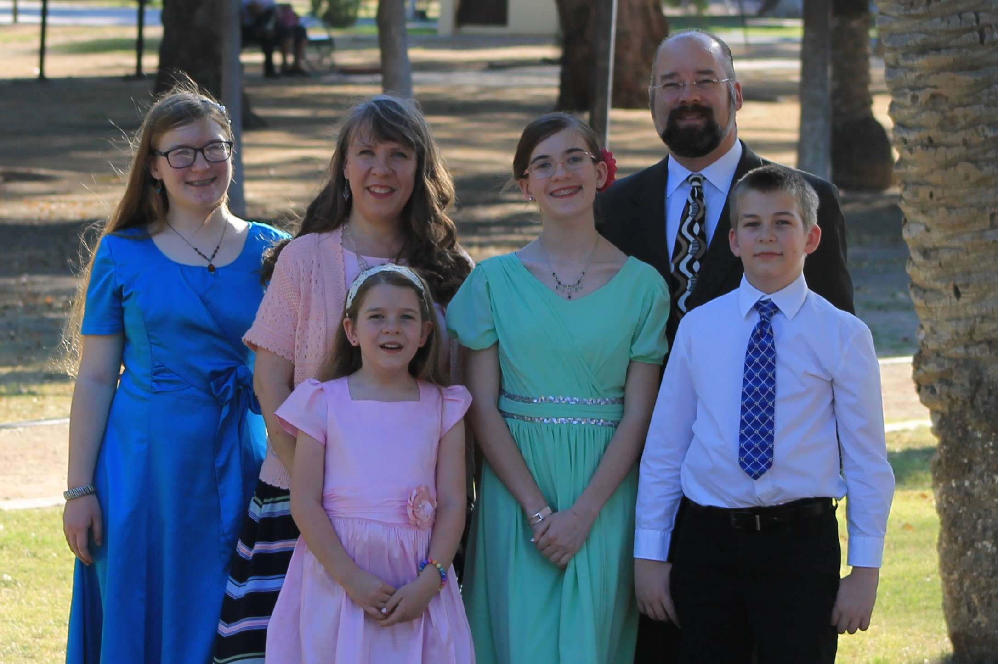

Slide 4
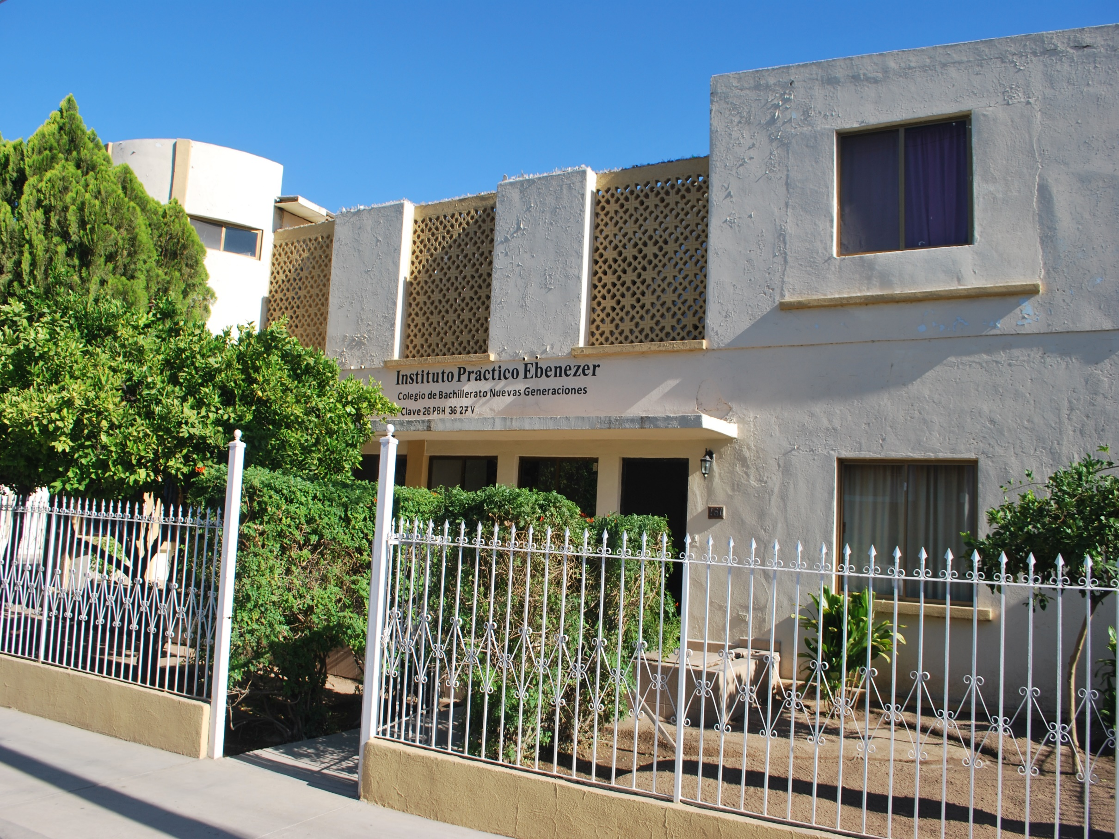
Instituto Práctico Ebenezer y Seminario

Slide 5
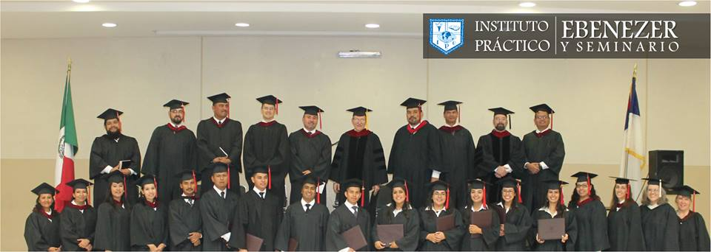
II Timothy 2:2
“And the things thou hast heard of me among many witnesses, the same commit thou to faithful men, who shall be able to teach others also.”

Slide 6
Vision for IPES’ Future
College completely indigenized
Mexican teachers with advanced degrees able to teach at the Master's and Doctorate level.
Churches strengthened by solidly prepared pastors and leaders all throughout Mexico and the Spanish-speaking world.
Notes:
What is our vision for the future?
We would like to see:
the college completely indigenized.
Mexican teachers with advanced degrees able to teach at the Master's and Doctorate level
Churches strengthened by solidly prepared pastors and leaders all throughout Mexico and the Spanish-speaking world.

Slide 7


Slide 8
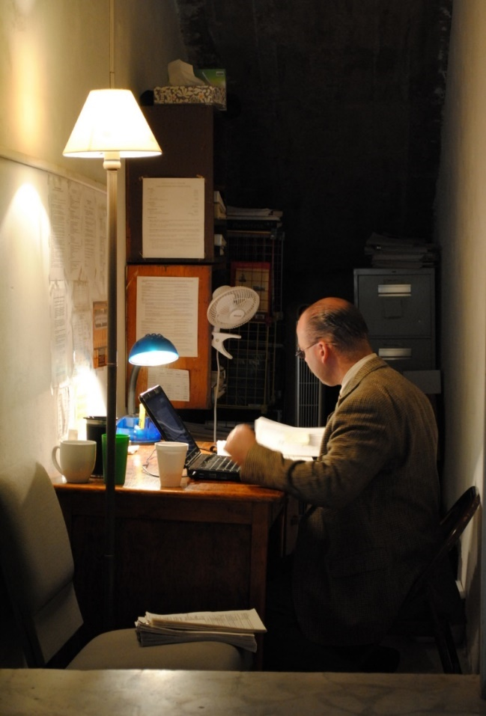
Context for the creation of TEAM:
2002: Financial administrator
2006: Academic Dean

Slide 9
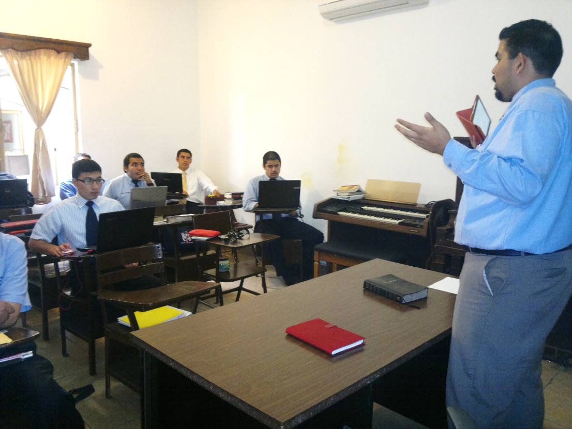
2012: Trained former student to take academic dean position.

Slide 10
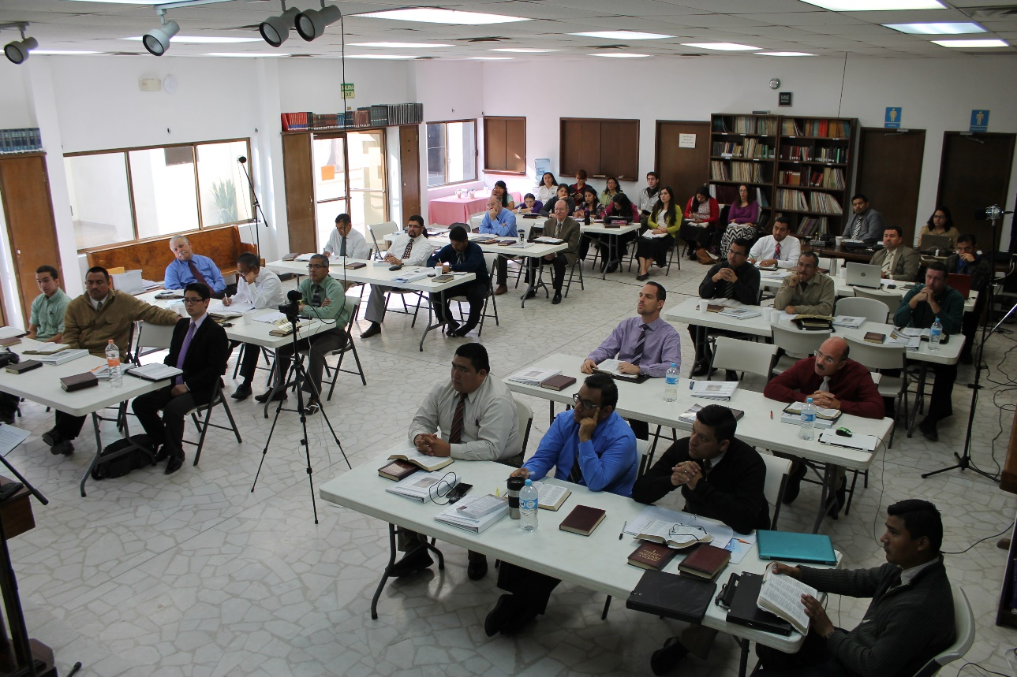
Growth of the postgraduate department.

Slide 11
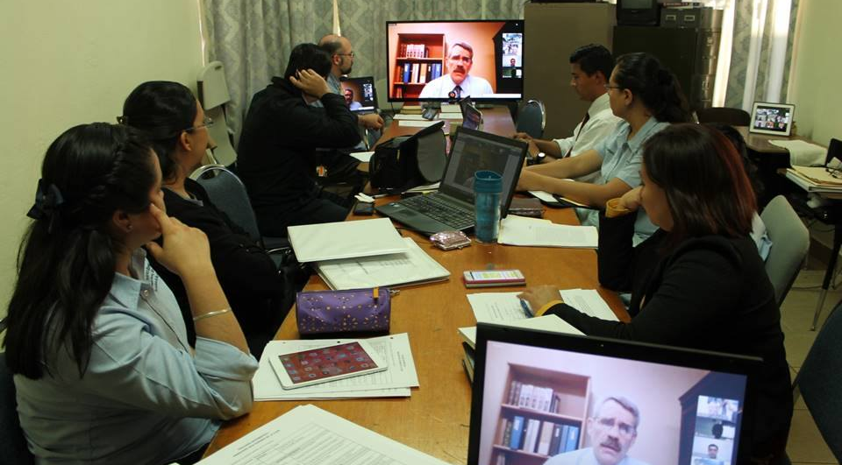
Seminary dean position created.
Programs added: Master’s degree in Teaching Bible, Doctorate in Practical Theology/Doctor of Ministry.

Slide 12
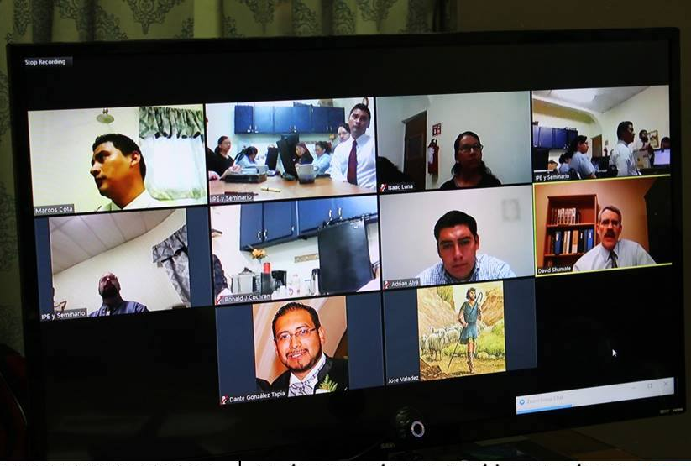
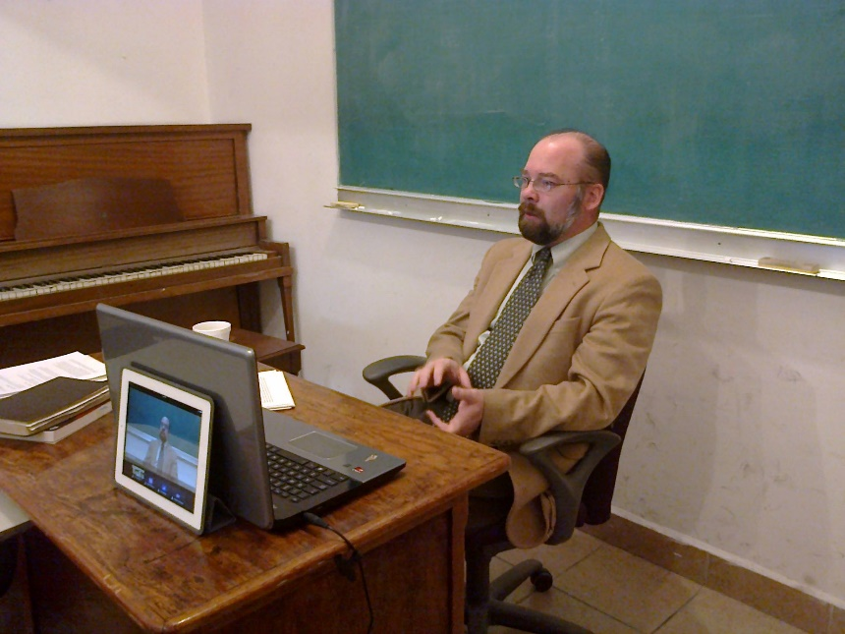
Discerning God’s leading
Advantage of using the Internet
Notes:
The Internet has paved the way for a unique application regarding 2 Timothy 2:2. We have uploaded over thirty of the recorded Master of Ministry courses as online courses for pastors throughout Latin America who can take advantage of these previously inaccessible materials. The Master’s in Teaching Bible degree was geared from its beginning to be a program that could be accessed online with the assistance of a local coordinator (as a group, or cohort).

Slide 13
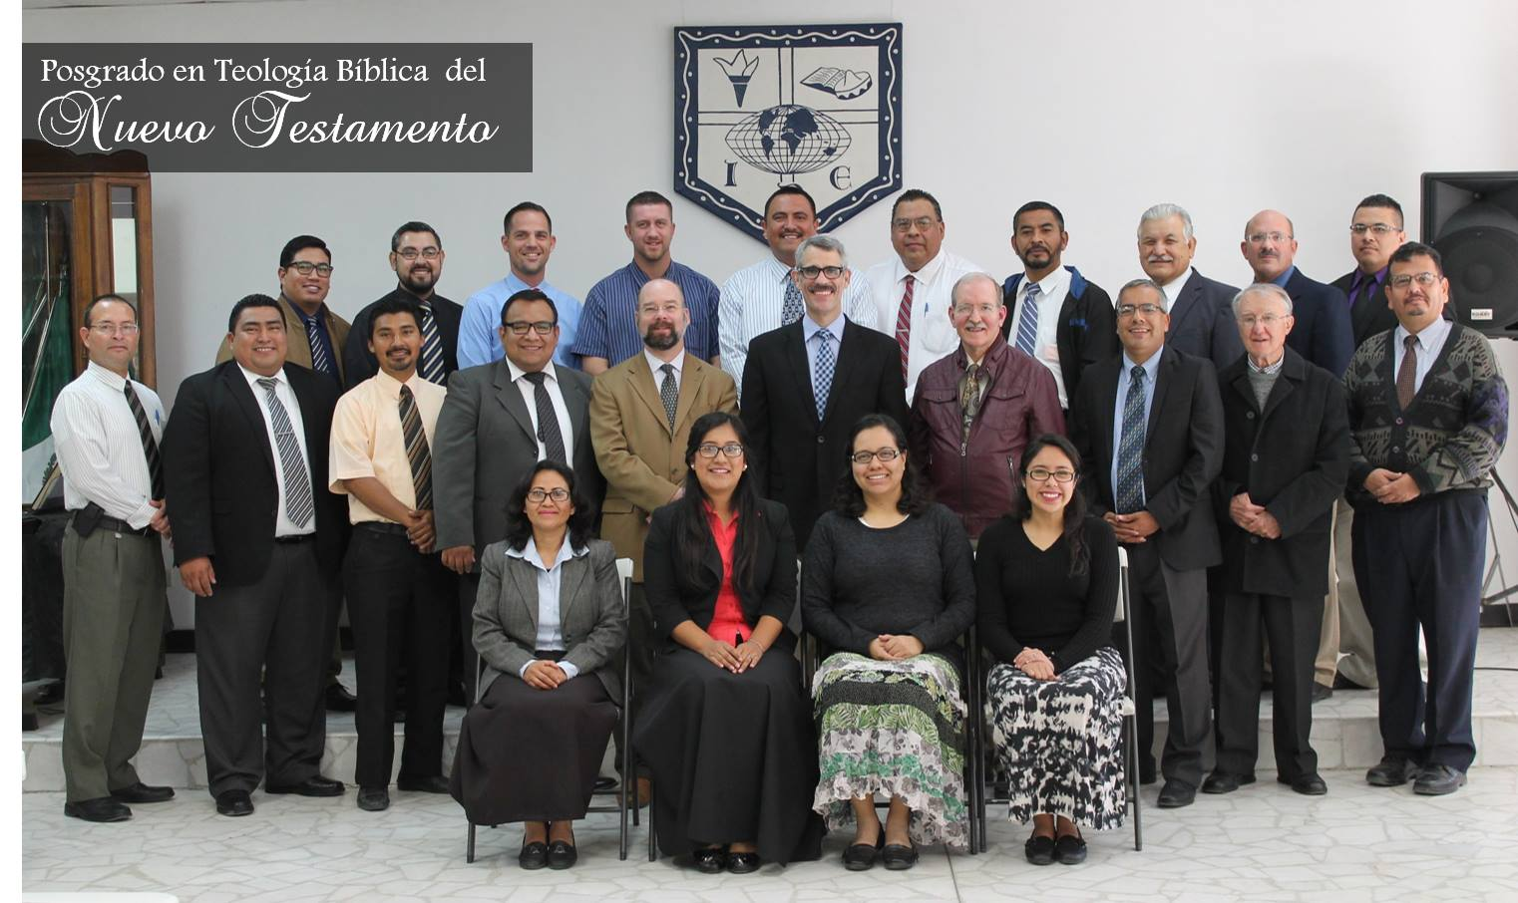
Advancement of the programs at Ebenezer Bible College and Seminary
Notes:
The advancement of the programs at Ebenezer Bible College and Seminary, the upcoming 50th anniversary of the college, and the level of spiritual, academic, and theological maturity in the faculty who were former students of ours led us to discern the Lord’s leading regarding turning over our responsibilities, and following Him to take what we’ve learned and accomplished in God’s grace, applying them in a broader scale, so that we can be of help to others in Latin America for the expansion of the Lord’s kingdom.

Slide 14
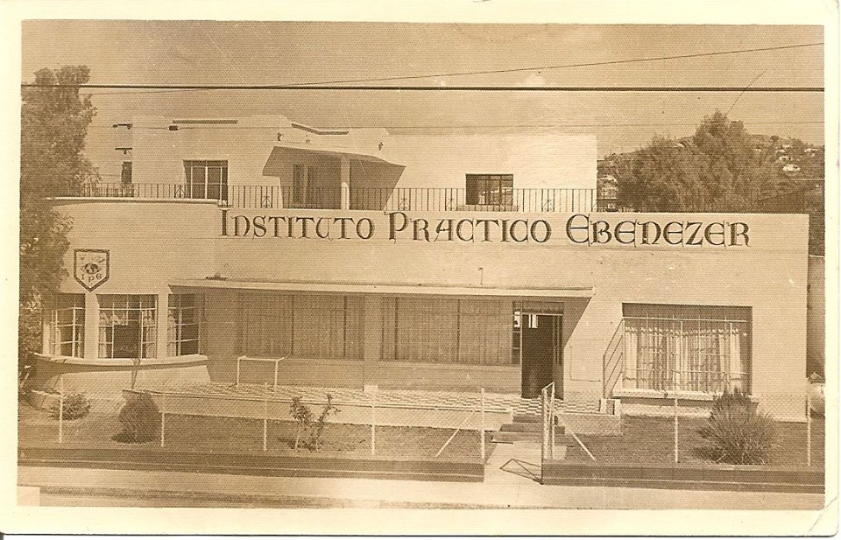
Upcoming 50th anniversary of the college
Notes:
The advancement of the programs at Ebenezer Bible College and Seminary, the upcoming 50th anniversary of the college, and the level of spiritual, academic, and theological maturity in the faculty who were former students of ours led us to discern the Lord’s leading regarding turning over our responsibilities, and following Him to take what we’ve learned and accomplished in God’s grace, applying them in a broader scale, so that we can be of help to others in Latin America for the expansion of the Lord’s kingdom.

Slide 15
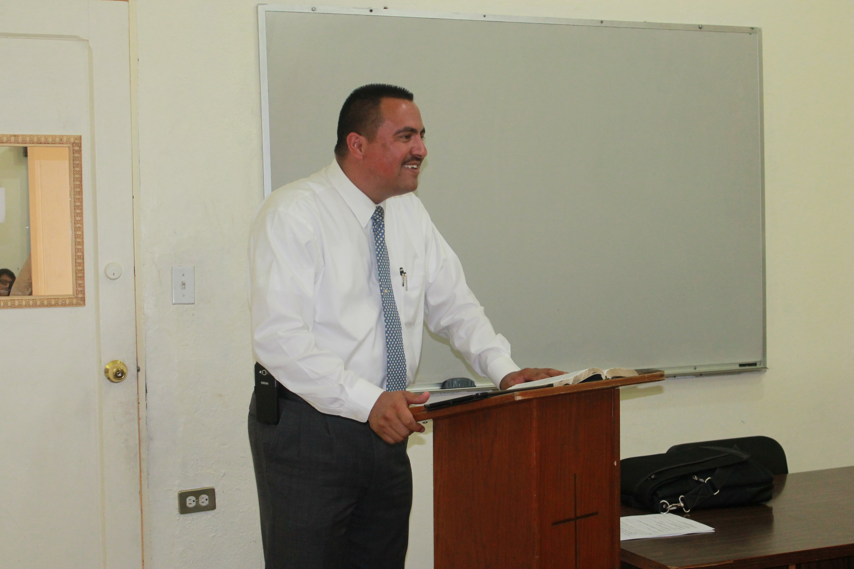
High level of spiritual, academic, and theological maturity in the faculty
Notes:
The advancement of the programs at Ebenezer Bible College and Seminary, the upcoming 50th anniversary of the college, and the level of spiritual, academic, and theological maturity in the faculty who were former students of ours led us to discern the Lord’s leading regarding turning over our responsibilities, and following Him to take what we’ve learned and accomplished in God’s grace, applying them in a broader scale, so that we can be of help to others in Latin America for the expansion of the Lord’s kingdom.

Slide 16
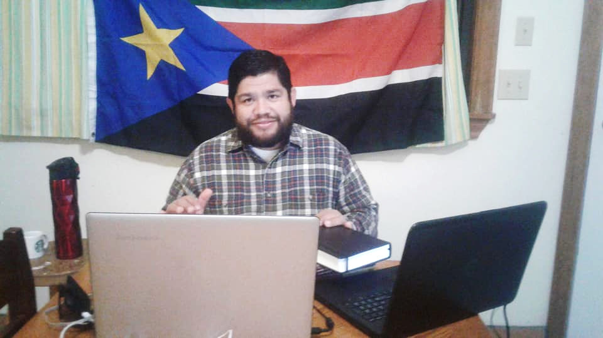
10-40 Window:
South Sudan

Slide 17


Slide 18
How?
Working as a TEAM with national pastors:
Train
Equip
Access
Manage
Notes:
The Way: Through working with the pastors in Latin America as a TEAM to provide the steps to
Train the trainers (or, equip the pastors to be teachers) by
Equipping the coordinator (the key pastor who can work as facilitator) to
Access the theological education available and
Manage the resources to create an institution directed to serve the local churches.

Slide 19
What is the plan?
One-week trip with a U.S. pastor, who will teach a block course
My part:
  Interpret, train, assess and facilitate the TEAM program
  Provide a step-by-step plan
  Provide follow-up

Slide 20
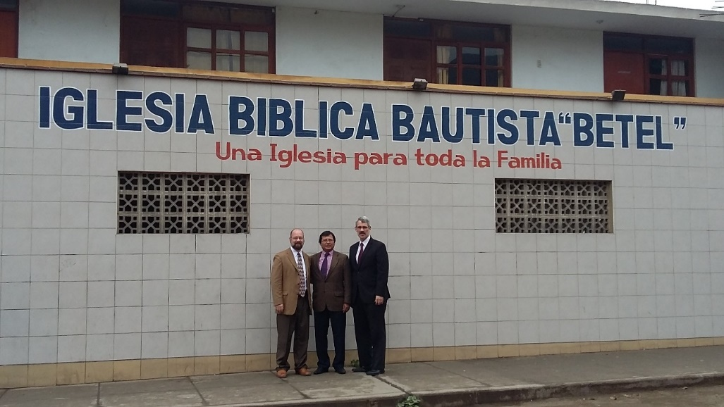
Why?
Pastors throughout Latin America understand the need to train their people.
Many pastors do not know where to begin.

Slide 21
Advantages of TEAM Mobile Seminary:
Nationals can train their countrymen without depending on multiple resident foreign missionaries.
Does not limit seminary training to nationals who travel to the U.S. to acquire their training.

